Slide 1

DIGITAL DESIGN AND COMPUTER ORGANIZATION
Standard Input and Output
Department of Computer Science and Engineering

Slide 2
DIGITAL DESIGN AND COMPUTER ORGANIZATION
Standard Input and Output
Department of Computer Science and Engineering

Slide 3
Basic Structure of computers Outline
Standard I/O Interfaces
Peripheral Component Interconnect Bus
SCSI Bus
Universal Serial Bus

Slide 4
DIGITAL DESIGN AND COMPUTER ORGANIZATION
Standard I/O Interfaces T2:Ch4 4.7
Department of Computer Science and Engineering

Slide 5
Standard Input and Output Standard I/O Interfaces-T2 section 4.7
I/O device is connected to a computer using an interface circuit.
Do we have to design a different interface for every combination of an I/O device and a computer?
A practical approach is to develop standard interfaces and protocols.
A personal computer has:
A motherboard which houses the processor chip, main memory and some I/O interfaces.
A few connectors into which additional interfaces can be plugged.
Processor bus is defined by the signals on the processor chip.
Devices which require high-speed connection to the processor are connected directly to this bus.
Carl Hamacher, Zvonko Vranesic, Safwat Zaky, Computer Organization, 5th ed., McGraw Hill, 2002, Section 4.7

Slide 6
Standard Input and Output Standard I/O Interfaces
Because of electrical reasons only a few devices can be connected directly to the processor bus.
Motherboard usually provides another bus that can support more devices.
Processor bus and the other bus (called as expansion bus) are interconnected by a circuit called “bridge”.
Devices connected to the expansion bus experience a small delay in data transfers.
Design of a processor bus is closely tied to the architecture of the processor.
No uniform standard can be defined.
Expansion bus however can have uniform standard defined.
Carl Hamacher, Zvonko Vranesic, Safwat Zaky, Computer Organization, 5th ed., McGraw Hill, 2002, Section 4.7

Slide 7
Standard Input and Output Standard I/O Interfaces
A number of standards have been developed for the expansion bus.
Some have evolved by default.
For example, IBM’s Industry Standard Architecture.
Three widely used bus standards:
PCI (Peripheral Component Interconnect)
SCSI (Small Computer System Interface)
USB (Universal Serial Bus)
Carl Hamacher, Zvonko Vranesic, Safwat Zaky, Computer Organization, 5th ed., McGraw Hill, 2002, Section 4.7

Slide 8
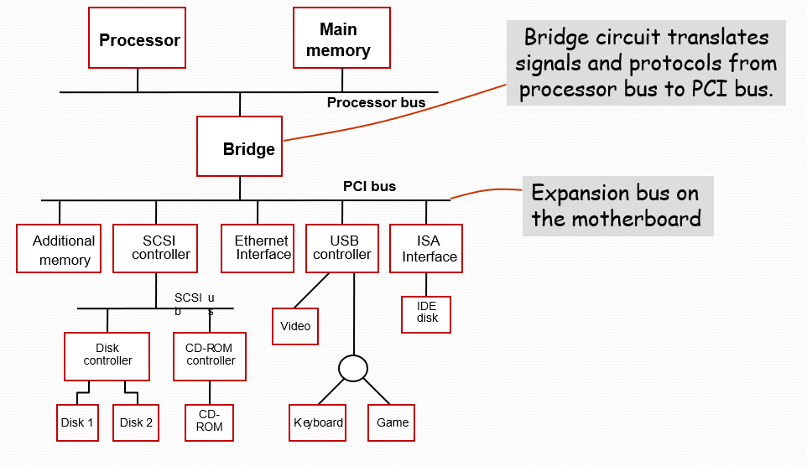
Standard Input and Output Standard I/O Interfaces
Carl Hamacher, Zvonko Vranesic, Safwat Zaky, Computer Organization, 5th ed., McGraw Hill, 2002, Section 4.7

Slide 9
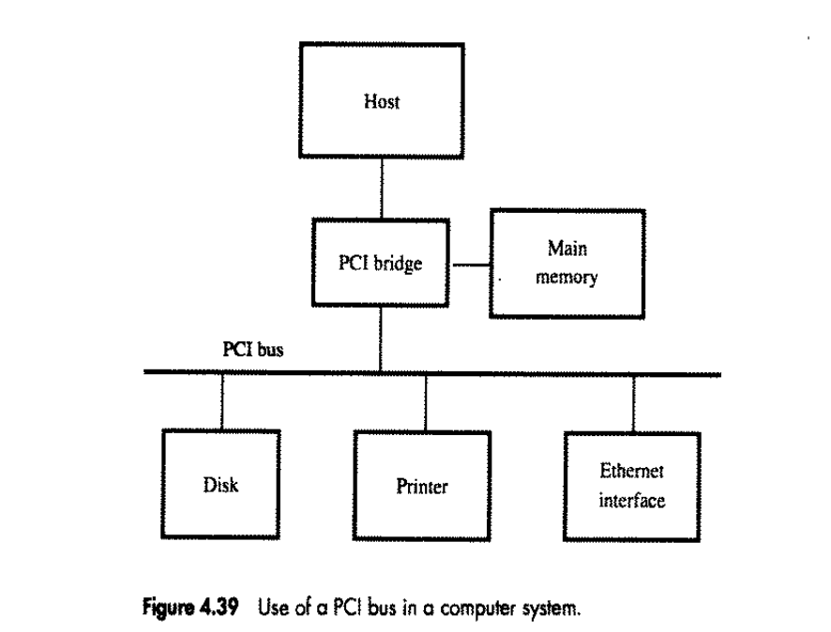
Standard Input and Output PCI BUS
Introduction to PCI Bus
PCI (Peripheral Component Interconnect) – standardized bus system connecting I/O devices to the processor.
Enables plug-and-play device connection
independent of CPU architecture.
Devices appear as if connected directly to processor memory space.
Supports high-speed peripherals (disk, graphics, network, etc.). Widely used due to low cost, processor independence, and high bandwidth.
Carl Hamacher, Zvonko Vranesic, Safwat Zaky, Computer Organization, 5th ed., McGraw Hill, 2002, Section 4.7.1

Slide 10
Standard Input and Output PCI BUS
PCI Bus Features and Organization
Bus Components:
Host / CPU connects through a PCI Bridge to I/O devices.
Devices: Disk, Printer, Ethernet Interface, etc.
Parallel Shared Bus — supports multiple devices simultaneously.
PCI allows 32-bit or 64-bit data width and 33/66 MHz clock speeds.
Memory-mapped addressing used for uniform data access.
Bus Mastering — any device can initiate data transfer.
Burst Mode Transfer: Sends a block (burst) of words sequentially.

Slide 11
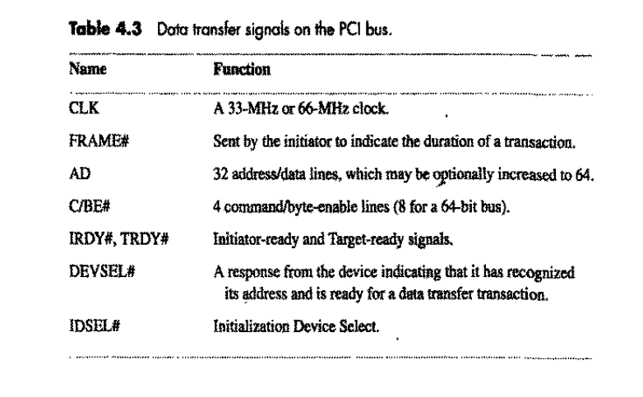
Standard Input and Output PCI BUS
Each transfer is synchronized by CLK and organized into phases (Address → Data).
Initiator (Master): CPU or DMA controller.
Target: Memory or I/O device.

Slide 12
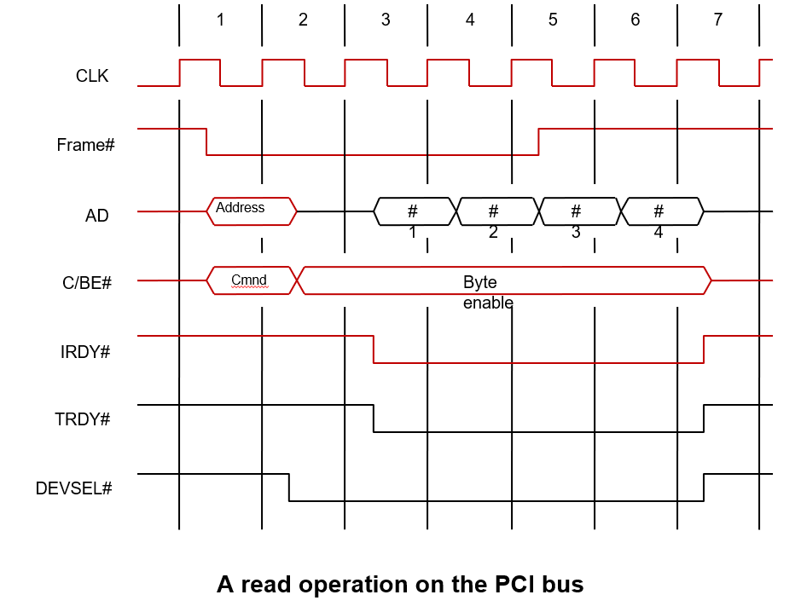
Standard Input and Output PCI Bus
A transaction begins when CPU asserts FRAME#.
Clock Cycle 1:
Address placed on AD lines.
Command (e.g., Read) issued on C/BE# lines.
Clock Cycle 2:
CPU releases AD lines for data phase.
Target asserts DEVSEL# to acknowledge.
Clock Cycles 3–6:
Target sends data words (#1, #2, #3, #4).
Data transfer synchronized by IRDY# (Initiator Ready) and TRDY# (Target Ready).
Clock Cycle 7:
CPU negates FRAME# (end of burst).
Target deasserts DEVSEL#; transfer completed.

Slide 13
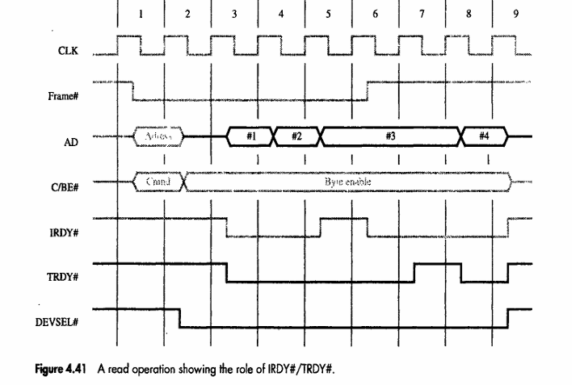
Standard Input and Output PCI Bus
Handshake Control (IRDY# / TRDY# Timing)
IRDY# (Initiator Ready): Indicates CPU ready to receive or send data.
TRDY# (Target Ready): Indicates target ready to supply or accept data.
Data transfer occurs when both signals are low (active).
If initiator or target is not ready → wait states are inserted automatically.
Example:
Target delays data → TRDY# held high.
Initiator waits → IRDY# high.
This asynchronous handshaking ensures reliable data synchronization.

Slide 14
Standard Input and Output PCI Bus-PCI Transaction Phases Summary
Address Phase:
Initiator drives address and command on AD + C/BE# lines.
Data Phase:
Target returns or accepts data (1 or multiple bursts).
Handshake:
IRDY# and TRDY# coordinate data readiness.
Completion:
FRAME# negated → end of burst.
DEVSEL# deasserted → bus released.
Additional Features:
Burst Transfers: Multiple data words in one transaction.
Low wire count design → cost-effective bus.
Plug-and-Play Initialization: Devices detected automatically using IDSEL line.

Slide 15
Standard Input and Output SCSI Bus
The acronym SCSI stands for Small Computer System Interface.
It refers to a standard bus defined by the American National Standards Institute (ANSI) under the designation X3.131 .
In the original specifications of the standard, devices such as disks are connected to a computer via a 50-wire cable, which can be up to 25 meters in length and can transfer data at rates up to 5 megabytes/s.
The SCSI bus standard has undergone many revisions, and its data transfer capability has increased very rapidly, almost doubling every two years.
SCSI-2 and SCSI-3 have been defined, and each has several options.
Because of various options SCSI connector may have 50, 68 or 80 pins.
Carl Hamacher, Zvonko Vranesic, Safwat Zaky, Computer Organization, 5th ed., McGraw Hill, 2002, Section 4.7.2

Slide 16
Standard Input and Output SCSI Bus
• SCSI stands for Small Computer System Interface.
• Standard bus defined by ANSI (X3.131) for connecting disks, tapes, printers, etc.
• Supports multiple devices connected via 50–80 pin connectors.
• Uses DMA for high-speed data transfer between memory and I/O devices.
• Devices communicate through a SCSI controller interfacing the CPU bus.
• Evolved through multiple generations: SCSI-1, SCSI-2, SCSI-3.
Carl Hamacher, Zvonko Vranesic, Safwat Zaky, Computer Organization, 5th ed., McGraw Hill, 2002, Section 4.7.2

Slide 17
Standard Input and Output SCSI Bus
• Narrow SCSI: 8-bit data bus; Wide SCSI: 16-bit data bus.
• Data rate ranges from 5 MB/s up to 640 MB/s (anticipated for newer versions).
• Devices are connected to the SCSI bus via a controller.
• Supports up to 8 devices on a narrow bus and 16 on a wide bus.
• Each device identified by a unique SCSI ID (0–7 or 0–15).
• Data transferred in bursts using DMA.
• SCSI bus not part of CPU address space – acts as an external subsystem
Carl Hamacher, Zvonko Vranesic, Safwat Zaky, Computer Organization, 5th ed., McGraw Hill, 2002, Section 4.7.2

Slide 18
Standard Input and Output SCSI Bus
Two main controller roles:
Initiator: Starts communication, selects the target, and sends commands.
Target: Executes commands and manages data transfer.
The initiator establishes a logical connection with the target before data transfer.
Once connected, data transfer commands and bursts are exchanged over the SCSI bus.
Connections can be suspended and restored as needed to handle multiple operations.
When one connection is suspended, other devices can use the bus for their transfers — enabling overlapping I/O operations.
This overlapping of transactions is a key feature of SCSI that leads to high system performance.
The disk controller usually acts as the target, carrying out commands issued by the initiator.
The initiator can reestablish the suspended connection later to resume data exchange.
Carl Hamacher, Zvonko Vranesic, Safwat Zaky, Computer Organization, 5th ed., McGraw Hill, 2002, Section 4.7.2

Slide 19
Standard Input and Output SCSI Bus (SCSI controller to Disk drive)
Assume that processor needs to read block of data from a disk drive and that data are stored in disk sectors that are not contiguous.
The processor sends a command to the SCSI controller, which causes the following sequence of events to take place:
The SCSI controller, acting as an initiator, contends for control of the bus.
When the initiator wins the arbitration process, it selects the target controller and hands over control of the bus to it.
The target starts an output operation (from initiator to target); in response to this, the initiator sends a command specifying the required read operation.
Carl Hamacher, Zvonko Vranesic, Safwat Zaky, Computer Organization, 5th ed., McGraw Hill, 2002, Section 4.7.2

Slide 20
Standard Input and Output SCSI Bus
4. The target, realizing that it first needs to perform a disk seek operation, sends a message to the initiator indicating that it will temporarily suspend the connection between them. Then it releases the bus.
5. The target controller sends a command to the disk drive to move the read head to the first sector involved in the requested read operation. Then, it reads the data stored in that sector and stores them in a data buffer. When it is ready to begin transferring data to the initiator, the target requests control of the bus. After it wins arbitration, it reselects the initiator controller, thus restoring the suspended connection.
Carl Hamacher, Zvonko Vranesic, Safwat Zaky, Computer Organization, 5th ed., McGraw Hill, 2002, Section 4.7.2

Slide 21
Standard Input and Output SCSI Bus
The target transfers the contents of the data buffer to the initiator and then suspends the connection again
The target controller sends a command to the disk drive to perform another seek operation. Then, it transfers the contents of the second disk sector to the initiator as before. At the end of this transfers, the logical connection between the two controllers is terminated.
As the initiator controller receives the data, it stores them into the main memory using the DMA approach.
The SCSI controller sends as interrupt to the processor to inform it that the requested operation has been completed
Carl Hamacher, Zvonko Vranesic, Safwat Zaky, Computer Organization, 5th ed., McGraw Hill, 2002, Section 4.7.2

Slide 22
Standard Input and Output SCSI Bus
Category | Name | Function
Data | -DB(0) to -DB(7) | Data lines: Carry one byte of information during the information transfer phase and identify device during arbitration, selection, and reselection phases.
 | -DB(P) | Parity bit for the data bus.
Phase | -BSY | Busy: Asserted when the bus is not free.
 | -SEL | Selection: Asserted during selection and reselection.
Information Type | -C/D | Control/Data: Asserted during transfer of control information (command, status, or message).
 | -MSG | Message: Indicates that the information being transferred is a message.
Handshake | -REQ | Request: Asserted by a target to request a data transfer cycle.
 | -ACK | Acknowledge: Asserted by the initiator when it has completed a data transfer operation.
Direction of Transfer | -I/O | Input/Output: Asserted to indicate an input operation (relative to the initiator).
Other | -ATN | Attention: Asserted by an initiator when it wishes to send a message to a target.
 | -RST | Reset: Causes all device controls to disconnect from the bus and assume their start-up state.

Slide 23
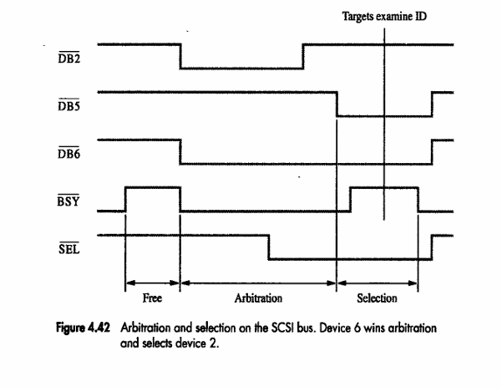
Standard Input and Output SCSI Bus
SCSI Bus Arbitration and Selection
• Bus free when -BSY inactive (high voltage).
• Multiple controllers may request bus access simultaneously.
• Each controller has fixed priority (ID 7 = highest).
• Controller with highest ID wins arbitration.
• After winning, initiator asserts -SEL and -BSY to select target.
• Target acknowledges by asserting -BSY and begins data transfer phase.
Carl Hamacher, Zvonko Vranesic, Safwat Zaky, Computer Organization, 5th ed., McGraw Hill, 2002, Section 4.7.2

Slide 24
Standard Input and Output SCSI Bus
Information Transfer and Reselection
• Data transfer may include commands, status, or data packets.
• Uses -REQ and -ACK handshake similar to PCI transfer.
• Target acts as bus master during data transfer.
• After transfer, bus released for use by others.
• Reselection: Target can reconnect to initiator when ready to continue transfer.
Carl Hamacher, Zvonko Vranesic, Safwat Zaky, Computer Organization, 5th ed., McGraw Hill, 2002, Section 4.7.2

Slide 25
Standard Input and Output USB
Universal Serial Bus (USB) is an industry standard developed through a collaborative effort of several computer and communication companies, including Compaq, Hewlett-Packard, Intel, Lucent, Microsoft, Nortel Networks, and Philips.
Speed
Low-speed(1.5 Mb/s)
Full-speed(12 Mb/s)
High-speed(480 Mb/s)
Port Limitation
Device Characteristics
Plug-and-play
Carl Hamacher, Zvonko Vranesic, Safwat Zaky, Computer Organization, 5th ed., McGraw Hill, 2002, Section 4.7.3

Slide 26
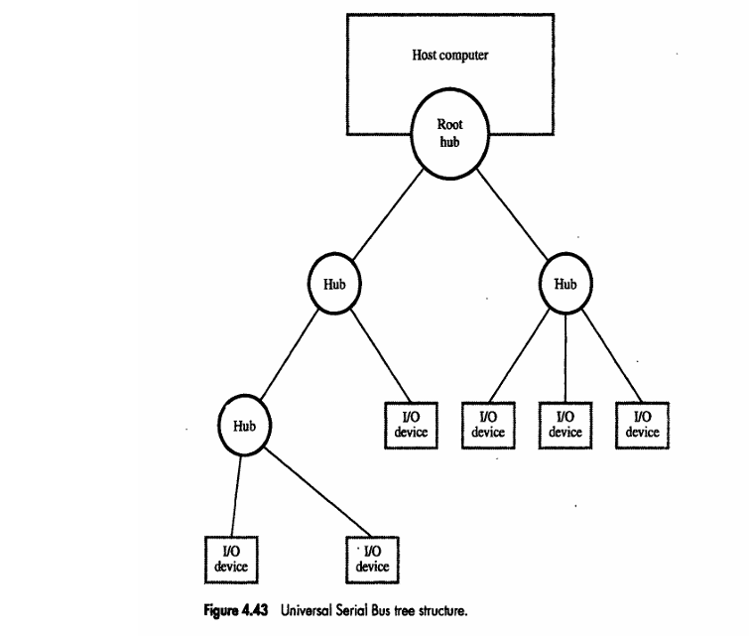
Standard Input and Output USB
Main Components:
Host Controller: Manages all communication and bus access.
Hub: Expands a single port into multiple downstream ports.
Function (Device): Endpoint device like keyboard, printer, camera, etc.
Communication always initiated by the host.
Devices cannot directly communicate with each other.
USB = Universal Serial Bus.
Developed to simplify connection between computers and peripherals.
Supports hot-plugging and automatic device configuration.
Uses tiered star topology – a host connected to multiple devices via hubs.
Allows up to 127 devices on a single bus.

Slide 27
Standard Input and Output USB
To accommodate a large number of devices that can be added or removed at any time, the USB has the tree structure as shown in the figure.
Each node of the tree has a device called a hub, which acts as an intermediate control point between the host and the I/O devices. At the root of the tree, a root hub connects the entire tree to the host computer. The leaves of the tree are the I/O devices being served (for example, keyboard, Internet connection, speaker, or digital TV)
In normal operation, a hub copies a message that it receives from its upstream connection to all its downstream ports. As a result, a message sent by the host computer is broadcast to all I/O devices, but only the addressed device will respond to that message. However, a message from an I/O device is sent only upstream towards the root of the tree and is not seen by other devices. Hence, the USB enables the host to communicate with the I/O devices, but it does not enable these devices to communicate with each other.
Carl Hamacher, Zvonko Vranesic, Safwat Zaky, Computer Organization, 5th ed., McGraw Hill, 2002, Section 4.7.3

Slide 28
Standard Input and Output USB Addressing
When a USB is connected to a host computer, its root hub is attached to the processor bus, where it appears as a single device. The host software communicates with individual devices attached to the USB by sending packets of information, which the root hub forwards to the appropriate device in the USB tree.
Each device on the USB, whether it is a hub or an I/O device, is assigned a 7-bit address. This address is local to the USB tree and is not related in any way to the addresses used on the processor bus.
Carl Hamacher, Zvonko Vranesic, Safwat Zaky, Computer Organization, 5th ed., McGraw Hill, 2002, Section 4.7.3

Slide 29
Standard Input and Output USB Addressing
A hub may have any number of devices or other hubs connected to it, and addresses are assigned arbitrarily. When a device is first connected to a hub, or when it is powered on, it has the address 0. The hardware of the hub to which this device is connected is capable of detecting that the device has been connected, and it records this fact as part of its own status information. Periodically, the host polls each hub to collect status information and learn about new devices that may have been added or disconnected.
When the host is informed that a new device has been connected, it uses a sequence of commands to send a reset signal on the corresponding hub port, read information from the device about its capabilities, send configuration information to the device, and assign the device a unique USB address. Once this sequence is completed the device begins normal operation and responds only to the new address.
Carl Hamacher, Zvonko Vranesic, Safwat Zaky, Computer Organization, 5th ed., McGraw Hill, 2002, Section 4.7.3

Slide 30
Standard Input and Output USB Protocols
All information transferred over the USB is organized in packets, where a packet consists of one or more bytes of information. There are many types of packets that perform a variety of control functions.
The information transferred on the USB can be divided into two broad categories: control and data.
Control packets perform such tasks as addressing a device to initiate data transfer, acknowledging that data have been received correctly, or indicating an error.
Data packets carry information that is delivered to a device.
Carl Hamacher, Zvonko Vranesic, Safwat Zaky, Computer Organization, 5th ed., McGraw Hill, 2002, Section 4.7.3

Slide 31
Standard Input and Output USB Protocols
A packet consists of one or more fields containing different kinds of information. The first field of any packet is called the packet identifier, PID, which identifies the type of that packet.
They are transmitted twice. The first time they are sent with their true values, and the second time with each bit complemented
The four PID bits identify one of 16 different packet types. Some control packets, such as ACK (Acknowledge), consist only of the PID byte.
Carl Hamacher, Zvonko Vranesic, Safwat Zaky, Computer Organization, 5th ed., McGraw Hill, 2002, Section 4.7.3
Notes:
or error detection purposes

Slide 32
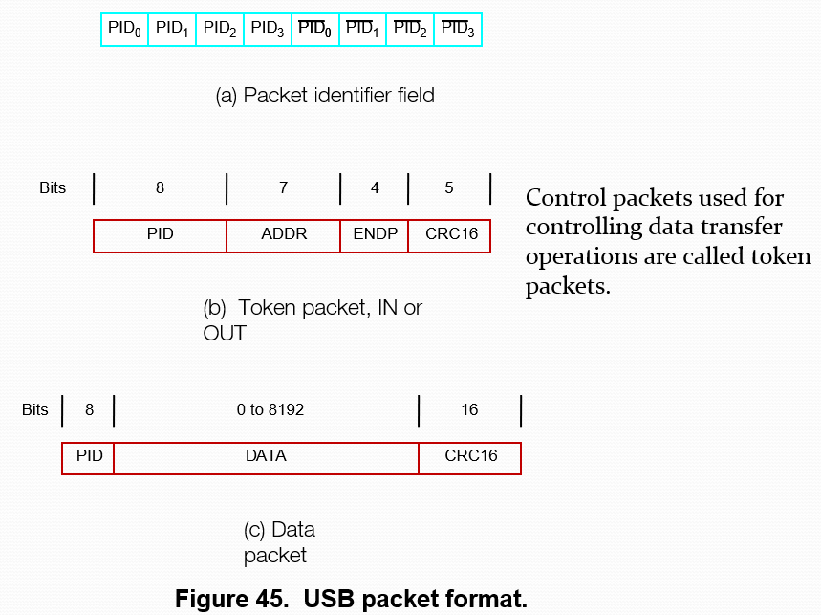
Standard Input and Output USB Protocols
Data transfer occurs through packets:
Token packets: Identify type and direction of transfer.
Data packets: Contain payload data (Data0, Data1).
Handshake packets: ACK, NAK, STALL signals for flow control.
Frame-based communication: Each frame = 1 ms (for full-speed).
Endpoints: Logical channels in each device for communication.

Slide 33
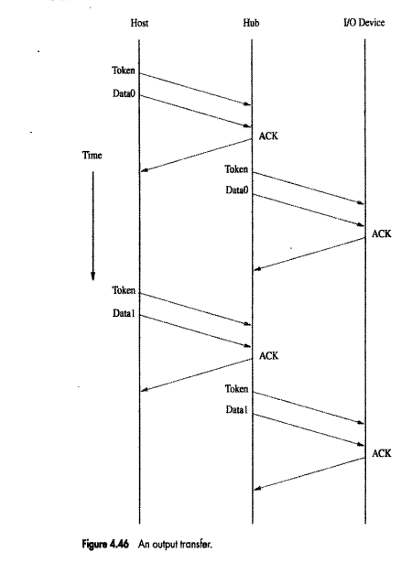
Token Packet:
The host begins by sending a Token to indicate the start of an output transaction.
Data Packet (Data0 / Data1):
The host sends the data packet immediately after the token.
Data0 and Data1 alternate to ensure data integrity and synchronization.
Acknowledgement (ACK):
The I/O device sends an ACK signal back through the hub to confirm correct reception of data.
Repeat Cycle:
The process repeats for subsequent data packets (e.g., another Token → Data1 → ACK cycle).
Direction of Communication:
Always from Host → Device (for output transfer).
Timing:
Events progress vertically in time, ensuring synchronized packet exchange.

Slide 34
Standard Input and Output Isochronous Traffic on USB
One of the key objectives of the USB is to support the transfer of isochronous data.
Devices that generates or receives isochronous data require a time reference to control the sampling process.
To provide this reference. Transmission over the USB is divided into frames of equal length.
A frame is 1ms long for low-and full-speed data.
The root hub generates a Start of Frame control packet (SOF) precisely once every 1 ms to mark the beginning of a new frame.
Carl Hamacher, Zvonko Vranesic, Safwat Zaky, Computer Organization, 5th ed., McGraw Hill, 2002, Section 4.7.3
Notes:
commonly used for time-sensitive data, such as audio or video streaming

Slide 35
Standard Input and Output Inochronous Traffic on USB
The arrival of an SOF packet at any device constitutes a regular clock signal that the device can use for its own purposes.
To assist devices that may need longer periods of time, the SOF packet carries an 11-bit frame number.
Following each SOF packet, the host carries out input and output transfers for isochronous devices.
This means that each device will have an opportunity for an input or output transfer once every 1 ms.
Carl Hamacher, Zvonko Vranesic, Safwat Zaky, Computer Organization, 5th ed., McGraw Hill, 2002, Section 4.7.3

Slide 36
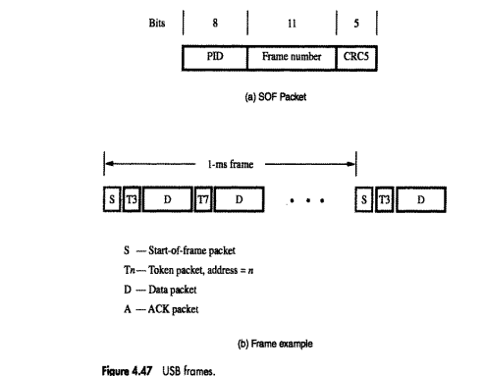
Carl Hamacher, Zvonko Vranesic, Safwat Zaky, Computer Organization, 5th ed., McGraw Hill, 2002, Section 4.7.3

Slide 37
Standard Input and Output Electrical Characteristics of USB
The cables used for USB connections consist of four wires.
Two are used to carry power, +5V and Ground.
Thus, a hub or an I/O device may be powered directly from the bus, or it may have its own external power connection.
The other two wires are used to carry data.
Different signaling schemes are used for different speeds of transmission.
At low speed, 1s and 0s are transmitted by sending a high voltage state (5V) on one or the other o the two signal wires. For high-speed links, differential transmission is used.
Carl Hamacher, Zvonko Vranesic, Safwat Zaky, Computer Organization, 5th ed., McGraw Hill, 2002, Section 4.7.3

Slide 38
Standard Input and Output
MCQ
In a PCI transaction, data transfer takes place when: a) Both IRDY# and TRDY# signals are low. b) Either IRDY# or TRDY# is high. c) FRAME# and DEVSEL# are high. d) DEVSEL# is low and TRDY# is high.
Which of the following represents the correct sequence of phases during a PCI bus read operation? a) Data → Address → Handshake → Completion b) Address → Data → Handshake → Completion c) Handshake → Address → Data → Completion d) Address → Handshake → Data → Completion

Slide 39
Standard Input and Output
MCQ
In a PCI transaction, data transfer takes place when: a) Both IRDY# and TRDY# signals are low. b) Either IRDY# or TRDY# is high. c) FRAME# and DEVSEL# are high. d) DEVSEL# is low and TRDY# is high.
Answer: (a) Explanation: Data is transferred only when both Initiator Ready (IRDY#) and Target Ready (TRDY#) are asserted low — ensuring handshake completion
Which of the following represents the correct sequence of phases during a PCI bus read operation? a) Data → Address → Handshake → Completion b) Address → Data → Handshake → Completion c) Handshake → Address → Data → Completion d) Address → Handshake → Data → Completion
Answer: (b) Explanation: Address phase comes first, followed by one or more data phases controlled by IRDY#/TRDY#, then handshake and bus release (FRAME# deasserted)

Slide 40
Standard Input and Output
MCQ
In USB communication: a) Devices can communicate directly with each other. b) Communication is always initiated by the host. c) Hubs can transfer data without host intervention. d) Devices use interrupt lines to alert the host.
SCSI supports high-speed transfers by: a) Using interrupts for each byte. b) Direct memory access (DMA) block transfers. c) Polling I/O ports continuously. d) Bit-serial CPU register copy.

Slide 41
Standard Input and Output
MCQ
In USB communication: a) Devices can communicate directly with each other. b) Communication is always initiated by the host. c) Hubs can transfer data without host intervention. d) Devices use interrupt lines to alert the host.
Answer: (b) Explanation: USB uses a host-controlled polling mechanism — all transactions are host-initiated
SCSI supports high-speed transfers by: a) Using interrupts for each byte. b) Direct memory access (DMA) block transfers. c) Polling I/O ports continuously. d) Bit-serial CPU register copy.
Answer: (b) Explanation: SCSI bus uses DMA for direct block transfers between I/O and memory
without CPU intervention

Slide 42
THANK YOU
Team DDCO
Department of Computer Science

